Slide 1
Great lakes coastal wetlands: What is a refuge for unionids?
The effects of water level fluctuations
Jessica Sherman
Central Michigan University

Slide 2
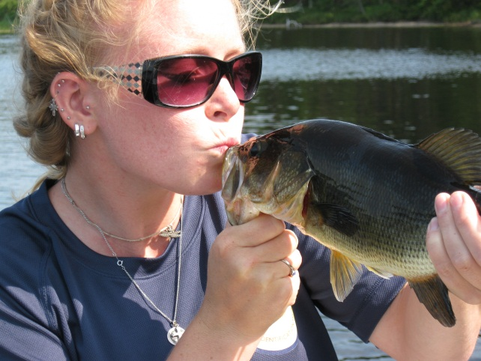
Introduction
Jessica Sherman
  B.S. in Biology and Pre-Veterinary Medicine from the University of Findlay
  Currently at CMU for M.S. in Conservation Biology
    Advisor: Don Uzarski
    Committee: Dave Zanatta, Daelyn Woolnough, and Brent Murry

Slide 3
Objectives
Locate refuge populations of unionids in Great Lakes coastal wetlands
Measure chemical and physical parameters
Determine if any support unionids or inhibit dreissenid colonization

Slide 4
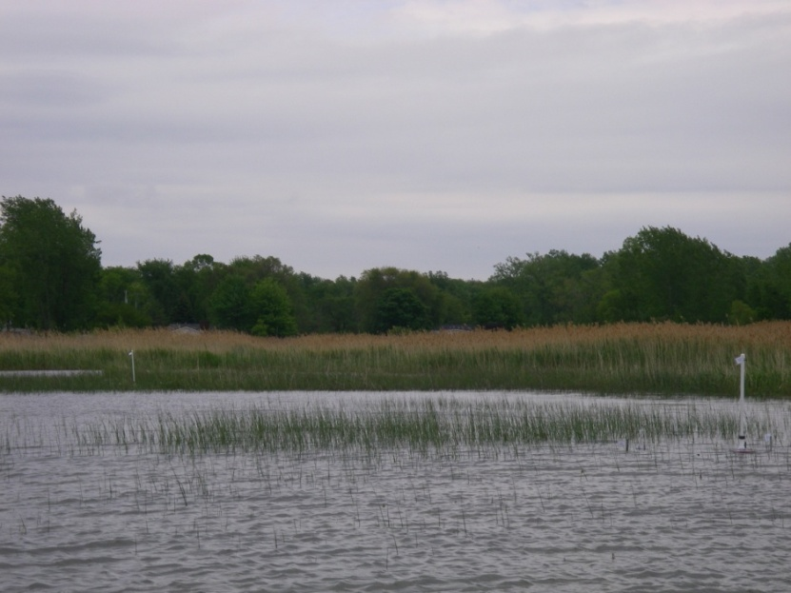
Methods
Project began in early June
  Initial set up phase
  Sites revisited at six and 12 weeks
Inner and outer wetland surveyed
  Emergent stem densities

Slide 5
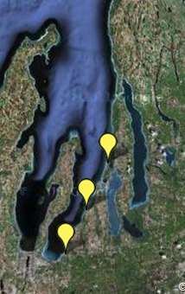
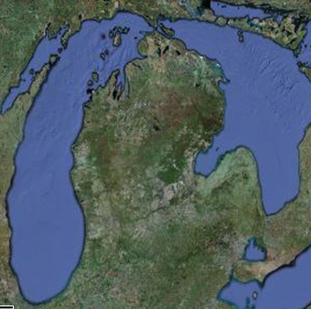
Study Sites
Grand Traverse Bay

Slide 6
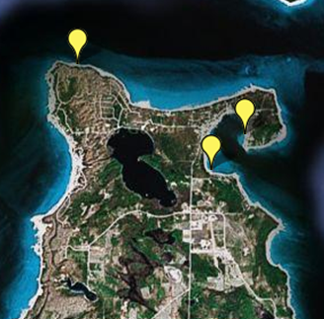
Beaver Island

Slide 7
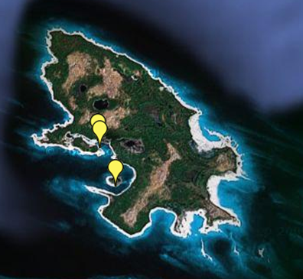
Garden Island

Slide 8
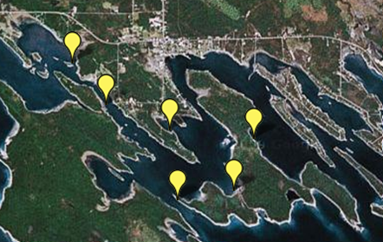
The Les Cheneaux Islands

Slide 9
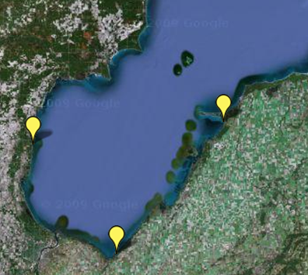
Saginaw Bay

Slide 10
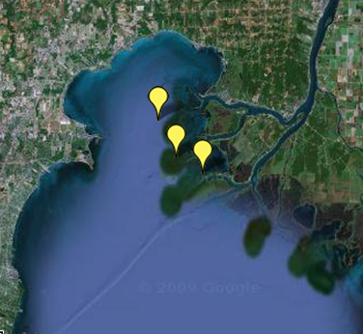
Lake St. Clair Delta

Slide 11
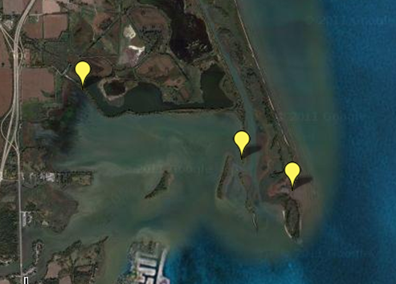
North Maumee Bay

Slide 12
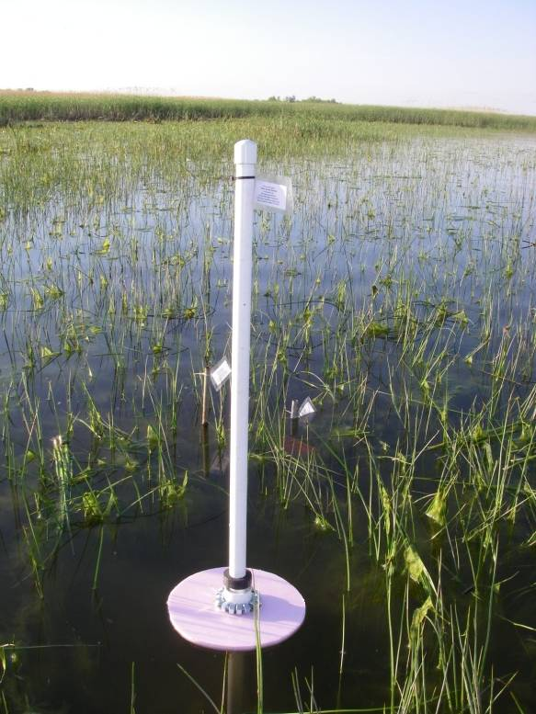
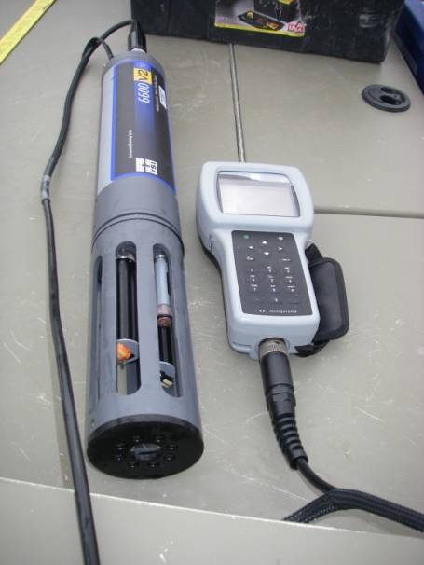
Methods
Water Quality Measurements
  Multiparameter Water Quality Sonde
  Water gauges

Slide 13
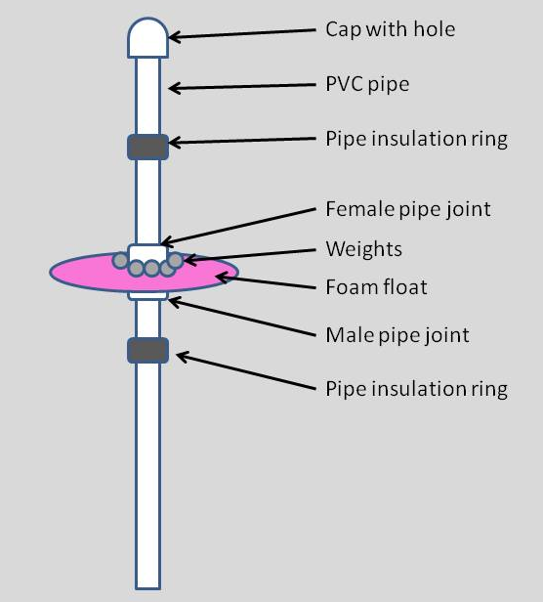
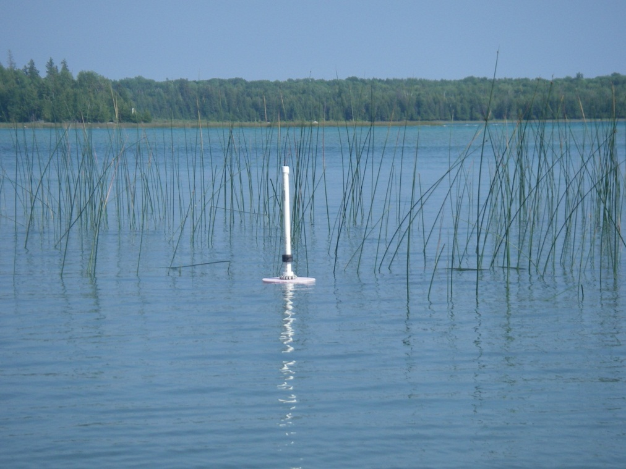
Methods
Water Quality Measurements
  Multiparameter Water Quality Sonde
  Water gauges

Slide 14
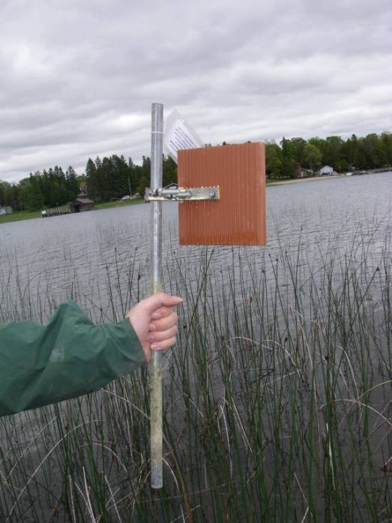
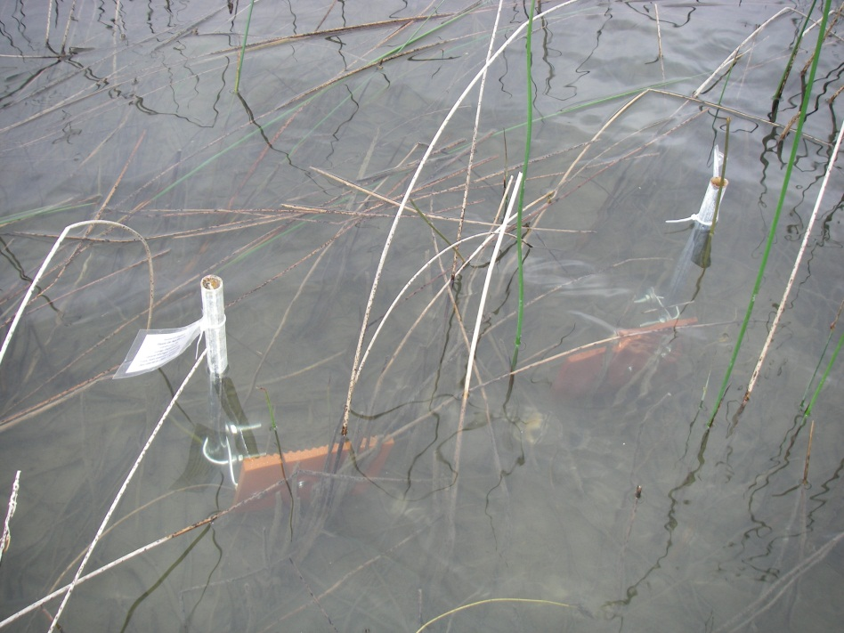
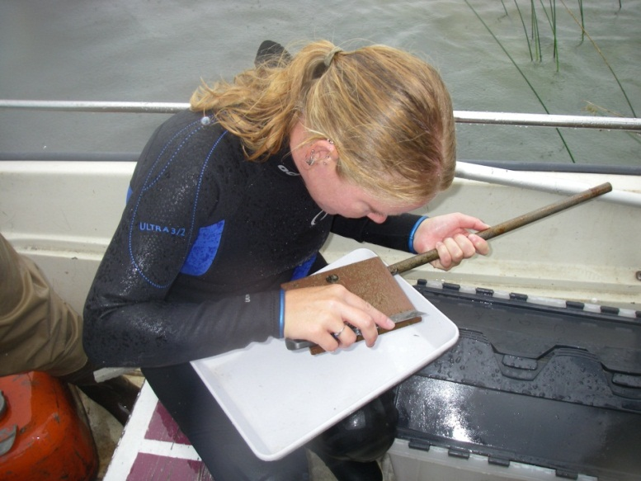
Methods
Dreissenid Colonization
  Unglazed clay tiles
    16x16 cm

Slide 15
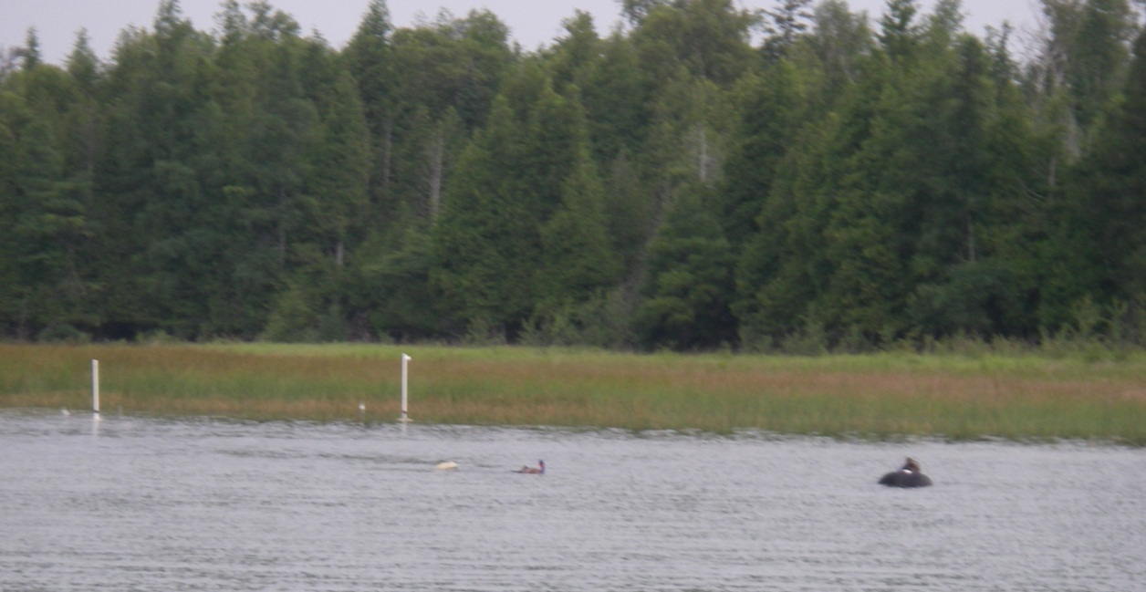
Methods
Unionid Surveys
  Initial 1 p-h visual search for live mussels
    Staked location
    Snorkeled searches

Slide 16
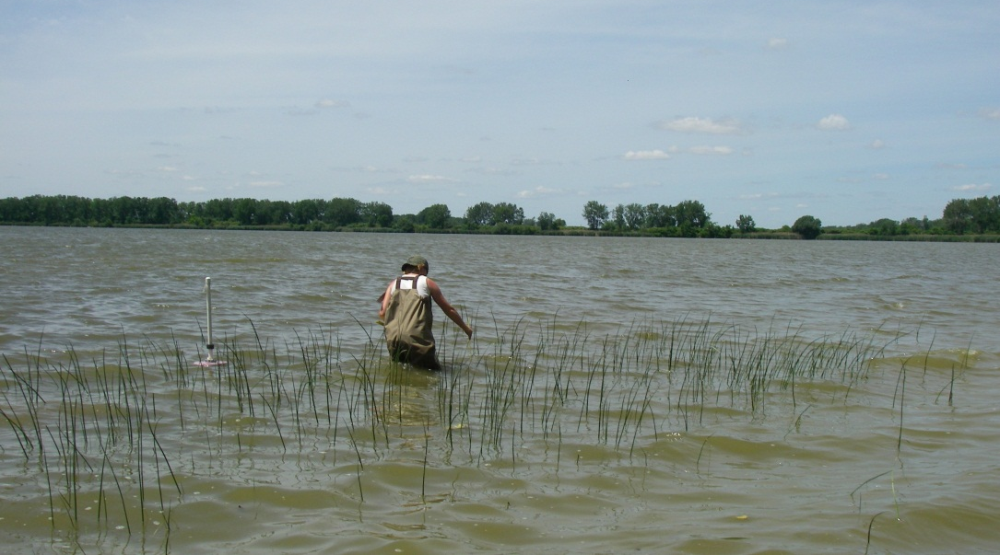
Methods
Unionid Surveys
  Initial 1 p-h visual search for live mussels
    Staked location
    Snorkeled searches
    Except…
      North Maumee Bay

Slide 17
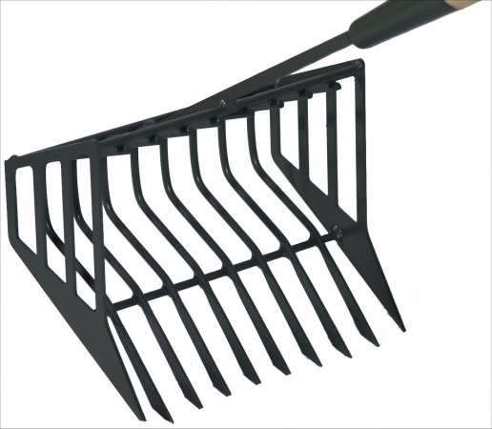
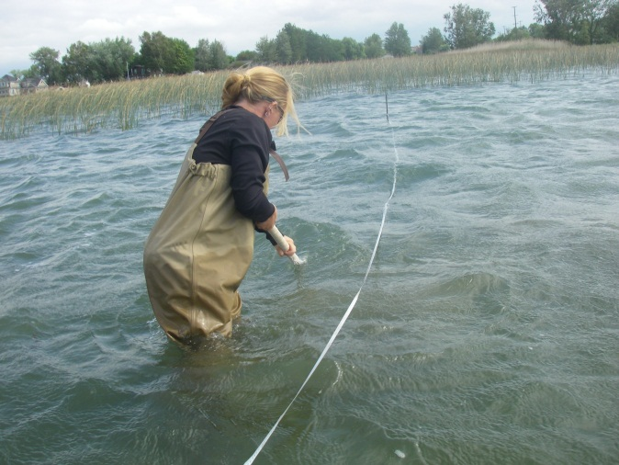
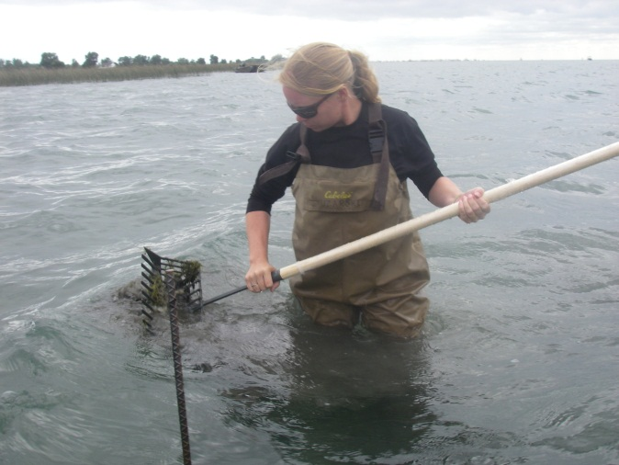
Methods
Unionid Surveys
  Clam rake surveys
    Haphazard starting location

Slide 18
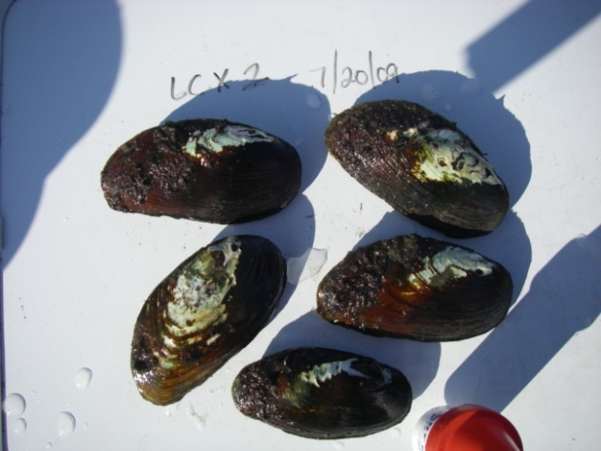
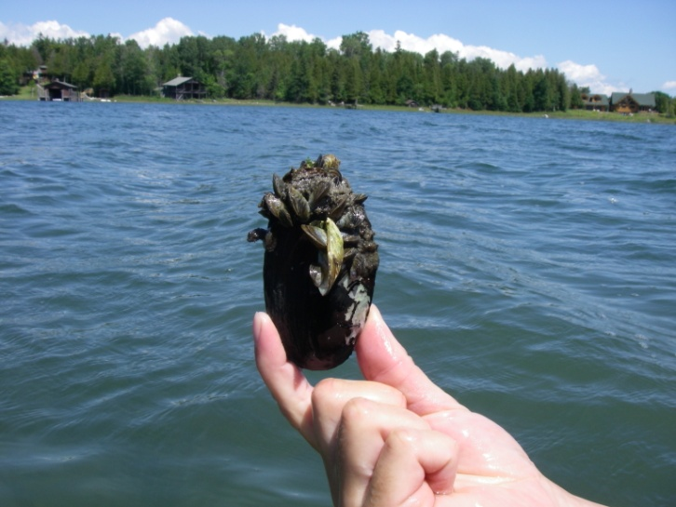
Results
Live Unionids found
  Les Cheneaux Islands
    1 species
    100% fouled
  Lake St. Clair Delta
    10 species
    85% fouled
  North Maumee Bay
    2 species
    50% fouled
Notes:
Elliptio complanata, Leptodea fragilis, Pyganadon grandis

Slide 19
The Les Cheneaux Islands
Lake St. Clair Delta
= Unionids present
= Unionids absent
North Maumee Bay

Slide 20
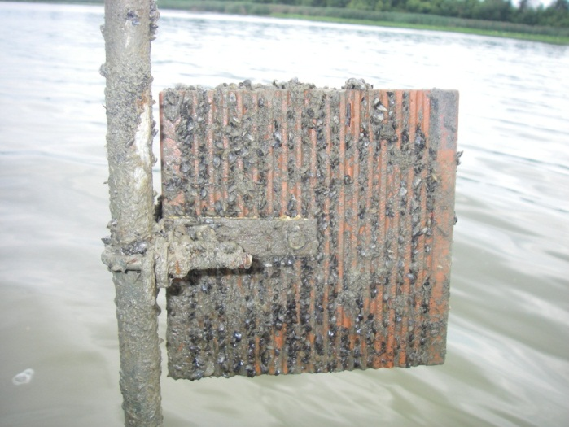
Results
Dreissena colonization on tiles only at Saginaw Bay and North Maumee Bay
  Highest 20,741 and 31,007 per m² , respectively
  Present in open water of all sites studied
Saginaw Bay historically contained 13 unionid species
Ricciardi et al. 1995, Goodrich and Vander Schalie 1932

Slide 21
Results
Saginaw Bay
5,087 per m²
46 per m²
= No colonization
= Colonization
20,741 per m²
North Maumee Bay
821 per m²
31,007 per m²
0 per m²
* Highest Recorded Dreissenid Colonization
Outer wetland higher than inner

Slide 22
Results
18.5%
28%

Slide 23
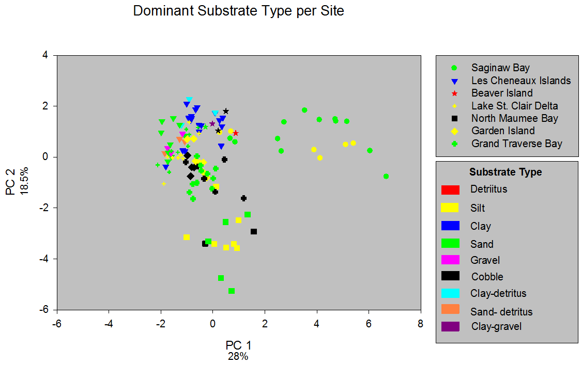
Results

Slide 24
Results

Slide 25
Results

Slide 26
Conclusions
Physicochemical variables in Saginaw Bay & North Maumee Bay appear to support Dreissena colonization
Low productivity could inhibit Dreissena colonization
No correlations between unionid populations and physicochemical factors
Notes:
Logistic regression and mrpp to come

Slide 27
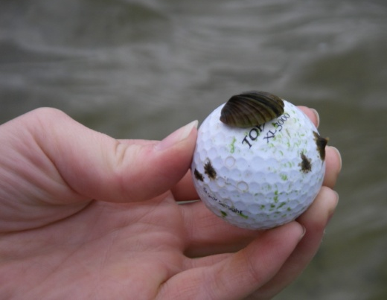
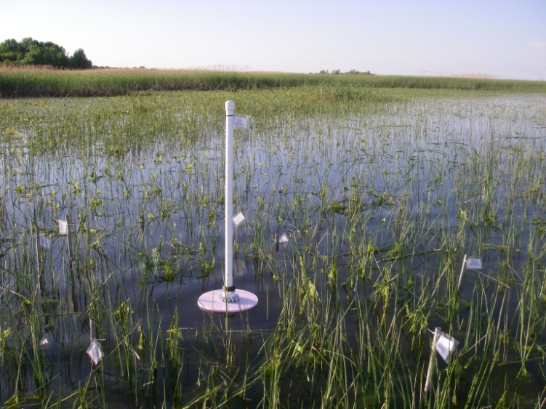
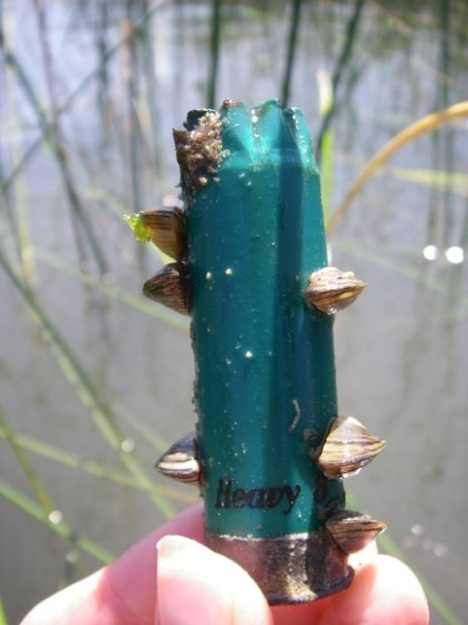
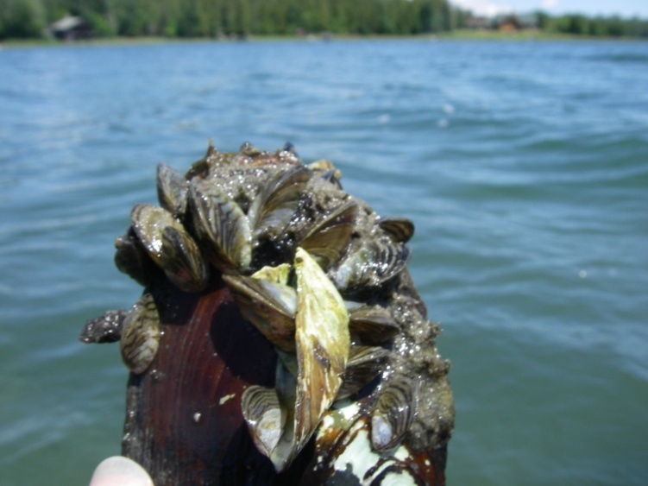
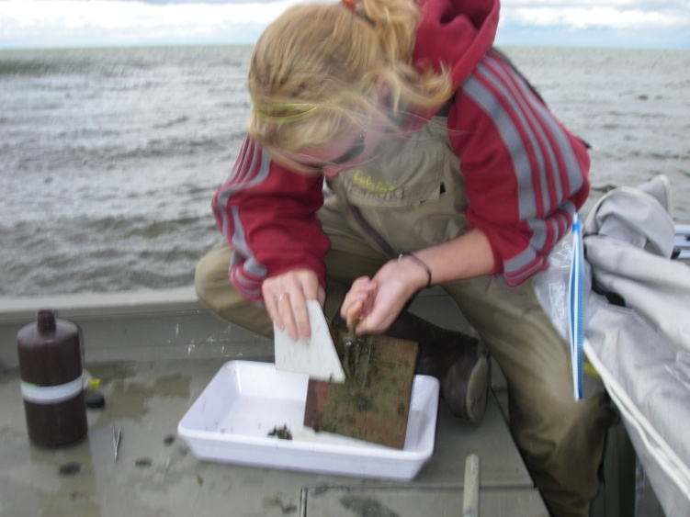
Thank you!

